Slide 1
Predictive Modeling w NLP

Slide 2
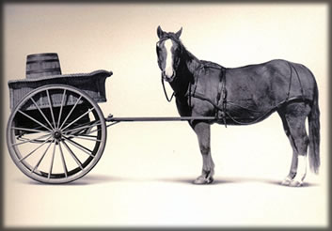
Let’s Practice
Open A_Regression.R
Predict Diamond Prices with linear regression.

Slide 3
The Problem of Overfitting
Statistical models can produce highly complex explanations of relationships between variables
The “fit” may be excellent
When used with new data, models of great complexity may do not do so well.
Notes:
3

Slide 4
100% fit – not useful for new data
Notes:
4

Slide 5
Another view of overfitting to a problem…

Slide 6
Minimize Overfitting - Partitioning
Divide data into training portion and validation portion
Test model on the test portion
Training Data
All Data
Test Data
Notes:
How do you want to “spend” data

Slide 7
Minimize Overfitting - Partitioning
Divide data into training portion , validation & test portions
Tune a model and/or compare models with the validation portion
The “true” way a model will behave when launched on new data.
Training Data
All Data
Validation
Data
Test Data
Notes:
How do you want to “spend” data

Slide 8
Supervised Learning
Goal: Predict a single “target” or “outcome” variable
Training data, where target value is known
Score to data where value is not known
Methods: Classification and Prediction

Slide 9


Supervised Learning
Inferring a function from labeled data.
“Learn from telling”, “Look at my data and I will tell you what to predict”
Data Setup
Algorithm
Business Context
Application
Marketing-Will a customer buy yes or no? How much will a customer spend?
Operations- Will an applicant default? When will a machine break?
Sports Analytics- How many points will the Bears’ QB score? What is the Bears’ probability of winning?
Requires expertise and stakeholder buy in
Flat “Excel” file. Each row is a record or observation. Each column is an attribute of the record.
One column is the outcome, y or target attribute.
Modeling e.g. K-NN, linear regression, decision tree, random forest etc.
Use the model to make predictions for the target label on the new data.

Slide 10

Supervised Learning Example
Inferring a function from labeled data.
“Learn from telling”, “Look at my data and I will tell you what to predict”
What impacts ice cream sales?
#
=ƒ(…)
Notes:
Just did carat to diamond prices
Now let’s add more than 1 input

Slide 11

Linear Regression for continuous outcomes
#
= $β$ + ($β$*temperature) + ($β$*day) + ($β$*price) + error
Some linear combination of temperature values, day of the week dummy variables and price estimate the number of cones that will sell.
Notes:
What should we expect the beta signs to be? Whats the relationship the information has with ice cream sales?
Temp goes up? Sales go up. Temp goes down? Sales go down. Positive relationship
Price goes up? Sales go down. Price goes down? Sales go up. Negative relationship

Slide 12
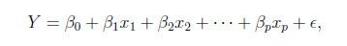
The linear combination equation captures information
outcome
coefficients
constant
error (noise)
predictors

Slide 13
The linear combination equation captures information
Outcome:
The “dependent”, “y” or “target”.
Number of Ice Cream Cones

Slide 14
The linear combination equation captures information
Constant:
The “intercept” or “beta-naught” has no predictor associated with it.
Avg. Number of Ice Cream Cones expected to sell if predictors were all 0.

Slide 15
The linear combination equation captures information
Predictors:
The “informative features”, “x” or “independent” variables.
Variables affecting sales in the data, temp, day, & price.

Slide 16
The linear combination equation captures information
Coefficients:
The “weight”, “betas” or “coefficients” multiplied with the specific “x” variable value.

Slide 17
The linear combination equation captures information
Error:
The “error” or “noise” represents the value the equation is wrong compared to the actual Y.

Slide 18
The linear combination equation captures information
outcome
coefficients
constant
error (noise)
predictors
The combinations of beta coefficients seeks to minimize the squared errors between the actual Y values and the equation. This combination manifests as the “best fit line”

Slide 19

#
= $6$ + 0.$25$*temperature + $3$*satudray_dummy + -0.5*price
Beta-Naught | Temperature | Saturday_dummy | Price
6 | 0.25 * 80 degrees | 3 * 1 | -0.5 * 5
6 | 0.25 * 88 | 3 * 0 | -0.5 * 2

Slide 20
#
= $6$ + 0.$25$*temperature + $3$*satudray_dummy + -0.5*price
Beta-Naught | Temperature | Satuday_dummy | Price | Best Fit Prediction
6 | 0.25 * 80 degrees | 3 * 1 | -0.5 * 5 | 26.5
6 | 0.25 * 88 | 3 * 0 | -0.5 * 2 | 27

Slide 21
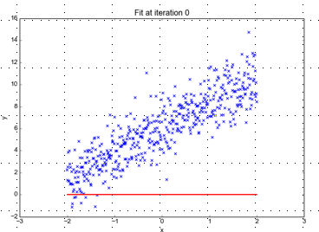
Minimizing the Sum of Ordinary Least Squared Errors
Equation:
Y= 0 +(0*x)
Beta “Naught” = 0
Intercept is 0
X beta coefficient = 0
No slope
Blue points Y Values represent actual outcome.
MINUS
Red line is the predicted outcome
Equals the Error

Slide 22
Big Errors
Equation:
Y= 0 +(0*x)
Beta “Naught” = 0
Intercept is 0
X beta coefficient = 0
No slope
Blue points Y Values represent actual outcome.
MINUS
Red line is the predicted outcome
Equals the Error

Slide 23
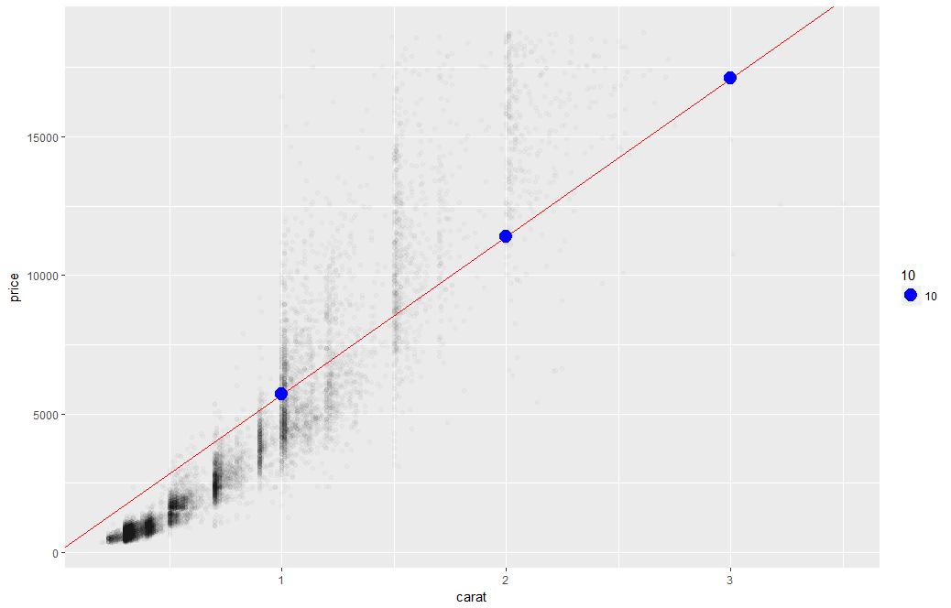
What’s really going on?
Errors between a prediction and actual.
Notice some are negative and some are positive

Slide 24
Why Squared Error?
Blue points Y Values represent actual outcome.
MINUS
Red line is the predicted outcome
Equals the Error
Cones
85
48
45
27
32
30
69
80
15
61
Prediction
67
42
54
95
1
48
51
95
20
22
Error
18
6
-9
-68
31
-18
18
-15
-5
39
-3
(18 + 6 + -9 + -68 + 31 + -18 + 18 + -15 + -5 + 39)
Notes:
Is this a good model?
18 + -18 cancel each other out

Slide 25
Why Squared Error?
Without squaring the errors positive & negative prediction errors cancel each other out.
(18² + 6² + -9² + -68² + 31² + -18² + 18² + -15² + -5² + 39²)
8445
324 + 36 + 81+ 4624 + 961 + 324 + 324 + 225 + 25 + 1521
Squaring the error means all errors have the same impact on the optimization function.
Notes:
Is this a good model?
18 + -18 cancel each other out

Slide 26
So what is really going on?
The algorithm is optimizing the inputs and weights (beta’s) to minimize the sum of squared errors.
This is called “ordinary least squares (OLS).

Slide 27
The linear combination of TOKENS is the model fit.
outcome
coefficients
constant
error (noise)
Tokens
X1, X2 etc are terms of the DTM.

Slide 28
The linear combination of TOKENS is the model fit.
Online Reviews
Y = box office Revenue
= (100)(X1 = “love”)
+ (50)(X1 = “great”)
+ (25)(X1 = “good”)
= (100)(DTM “love” = 2)
= (100)(DTM “great” = 0)
= (100)(DTM “good” = 1)
Y = 200+ 0 +25 = $225m

Slide 29
Evaluating a Prediction Model
RMSE- Root Mean Squared Error
MAPE- Mean Absolute Percentage Error
y
y-hat
Actual Values | Predicted/Forecasted
10 | 16
12 | 8
20 | 17
36 | 34
Besides P-Values which is a variable level KPI, and adjusted R-Sq there are two popular KPI for evaluating continuous model predictions.

Slide 30
RMSE
RMSE- Root Mean Squared Error
y
y-hat
ERROR
ERROR-SQ
Actual Values | Predicted/Forecasted | Errors | Squared Errors
10 | 16 | -6 | 36
12 | 8 | 4 | 16
20 | 17 | 3 | 9
36 | 34 | 2 | 4
Mean
36+16+9+4
4
To manually calculate RMSE, work the acronym backwards.

Slide 31
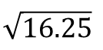
RMSE
RMSE- Root Mean Squared Error
ERROR
SQUARED
MEAN
ROOT
Actual Values | Predicted/Forecasted | Errors | Squared Errors
10 | 16 | -6 | 36
12 | 8 | 4 | 16
20 | 17 | 3 | 9
36 | 34 | 2 | 4
Mean
Square Root
36+16+9+4
$$\sqrt{16.25}$$
4
=4.03
In the same units being measured, tells you +/- the prediction error.

Slide 32
MAE
MAE- Mean Absolute Error
ERROR
ABSOLUTE
MEAN
Actual Values | Predicted/Forecasted | Errors | Absolute
10 | 16 | -6 | 6
12 | 8 | 4 | 4
20 | 17 | 3 | 3
36 | 34 | 2 | 2
Mean of Absolute Errors
6+4+3+2
4
=3.75
Instead of squaring error, take the absolute error. Then take the average among those errors.

Slide 33
MAPE
MAPE- Mean Absolute Percentage Error
ERROR
ABSOLUTE
PCT
MEAN
Actual Values | Predicted/Forecasted | Errors | Absolute | As % of Forecast
10 | 16 | -6 | 6 | =6/16 or 37%
12 | 8 | 4 | 4 | =4/8 or 50%
20 | 17 | 3 | 3 | =3/17 or 17%
36 | 34 | 2 | 2 | =2/34 or 5%
Mean of Percentages
37%+50%+17%+5%
4
=27.7%
Instead of squaring error, take the absolute error. Then divide that by the forecast value. Lastly calculate a mean average of all the percentage errors.

Slide 34
Let’s Practice
Open B_Text_Regression.R

Slide 35

Explanatory Vs Predictive Modeling
Make sure you understand the point of your project
(explanatory or predictive)
Do leaders want to understand a phenomena?
Do leaders want to make accurate predictions about the future?
This impacts how you evaluate the model and even what variables you choose.

Slide 36

If you don’t need explanations…you could try LSA
Quick review of LSA…the cousin of PCA.

Slide 37
Latent Semantic Analysis…cousin of PCA
In statistics PCA – Principal Component Analysis
High dimensional data can be approximated by “singular value decomposition” (SVD)

Slide 38
Latent Semantic Analysis
In text LSA – Latent Semantic Analysis
High dimensional data (text values) can be approximated by “singular value decomposition” (SVD)
 | Doc1 | Doc2
TermA | 10 | 6
TermB | 11 | 4
TermC | 8 | 5
TermD | 3 | 3
TermE | 2 | 2.8
TermF | 1 | 1
Doc1 Avg: 5.8
Doc2 Avg: 3.6

Slide 39
Plot the data in 2D space. In reality, text has higher dimensions.
Doc2
Doc1

Slide 40
Shift the origin to the average

Slide 41
Shifting the origin changes value but not relative position.

Slide 42
PCA “fits” a line going through the origin

Slide 43
The points are projected onto the fit line and squared distances from the origin are summed up.
Find the line that minimizes the data point to the projected point on the line.

Slide 44
A user defines the number of PCA dimensions.
Remember this happens in hyperspace among thousands of documents.
PCA1 is a line that “mixes”
the value of Doc1 & Doc2

Slide 45

Intuitive Example of PCA Where is the Musee Jacquemart-Andre in Paris?
Exact Answer has 2 data points.
LAT: 48.874911
LON:2.310612

Slide 46
Intuitive Example of PCA Where is the Musee Jacquemart-Andre in Paris?
Exact Answer has 2 data points.
LAT: 48.874911
LON:2.310612
Quick Answer has 1 data point.
Not far from Boulevard Haussmann

Slide 47
Intuitive Example of PCA Where is the Musee Jacquemart-Andre in Paris?
Exact Answer has 2 data points.
LAT: 48.874911
LON:2.310612
Quick Answer has 1 data point.
Not far from Boulevard Haussmann
Another point can be measured this way
“Hermes is farther from Boulevard…"

Slide 48
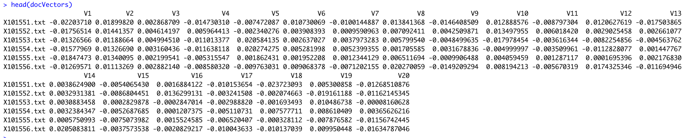
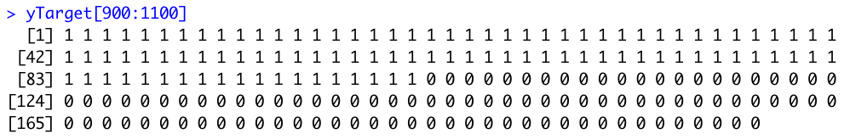
Supervised Learning
Output from LSA are “x-variables”
Data Setup
The label is ”y-variable”
Flat “Excel” file. Each row is a record or observation. Each column is an attribute of the record.
One column is the outcome, y or target attribute.

Slide 49
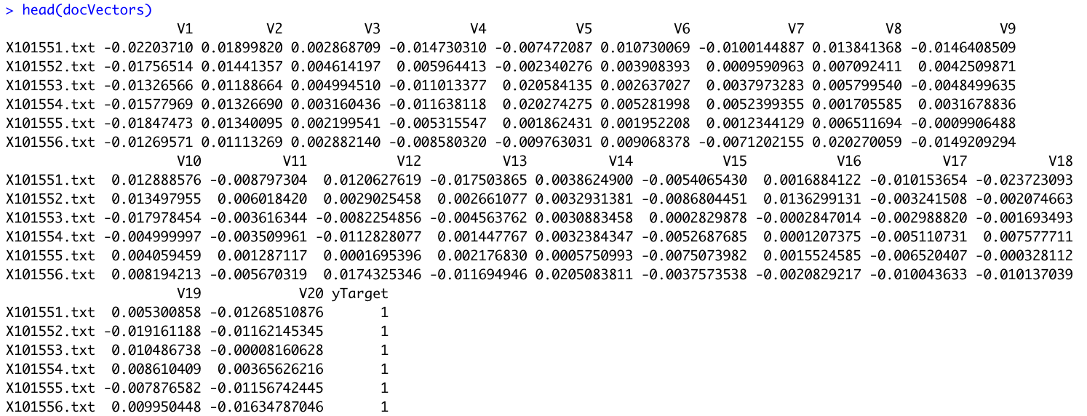
The modeling function usually needs a matrix with both.

Slide 50
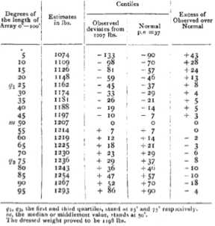
The Wisdom of the Crowd
Prevailing wisdom at the time was that crowds acted irrationally
Riots, mobs, cults
Galton wanted to explore trustworthiness and peculiarities of popular judgment
Galton attended an Ox weight guessing competition at a cattle exhibition
Participants individually guessed a very wide weight range
The median weight was 9lbs (0.8%) off and was better than individual cattle experts.

Slide 51
Random Forests - Classification
Each mini tree acts as a voter from the mob. Each voter is allowed to look at a random group of variables e.g. a mini data set to make its splits.
East
West
East
West
East
East
Vote Tally
East | West
4 | 2

Slide 52
Random Forests - Regression
Each mini tree acts as a voter from the mob. Each voter is allowed to look at a random group of variables e.g. a mini data set to make its splits.
11
8
6
9
12
14
Average
(11+9+8+12+6+14)/6 = 10

Slide 53
How a random forest is really grown.
Draw many re-samples of cases from the data (bootstrap)
For each re-sampled set use a random subset of predictor variables to produce a tree. Some parameters include
Number of trees to grow – dictates the number of re-sampled sets
Number of predictor variables for each tree
Combine the predictions/classifications from all the trees (the entire forest)
Votes are tallied for classification problems
Predictions are averaged for continuous problems
Since it has many weak learners, overfitting is less of a concern. Some trees will get the unlikely outlier value while most won’t.
Since its fitting many hundreds of trees, it takes some time to train a model.

Slide 54
C_lsa_text_regression.R

